Slide 1
2020 ParticipACTION Report Card on
Physical Activity
for Children
and Youth
June 2020

Slide 2
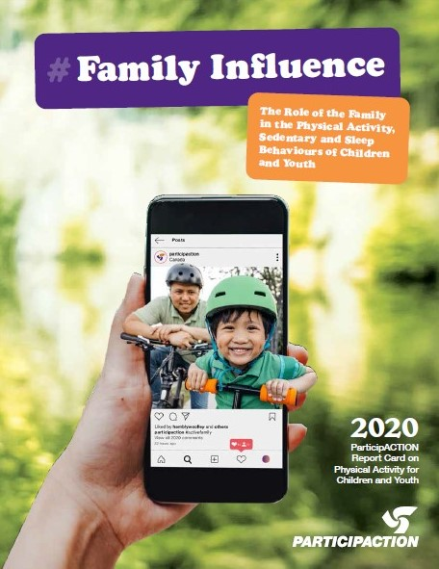
Cover Story
Families play a crucial role in shaping and influencing all areas of kids’ lives including their physical activity, sedentary behaviour and sleep behaviours.

Slide 3

About the Report Card
The 2020 ParticipACTION Report Card on Physical Activity for Children and Youth is the most comprehensive assessment of child and youth physical activity in Canada. The Report Card synthesizes data from multiple sources, including the best available peer-reviewed research, to assign evidence-informed grades across 14 indicators. The Report Card has been replicated in over 50 cities, provinces and countries, where it has served as a blueprint for collecting and sharing knowledge about the physical activity of young people around the world.

Slide 4

Consensus Statement

Slide 5
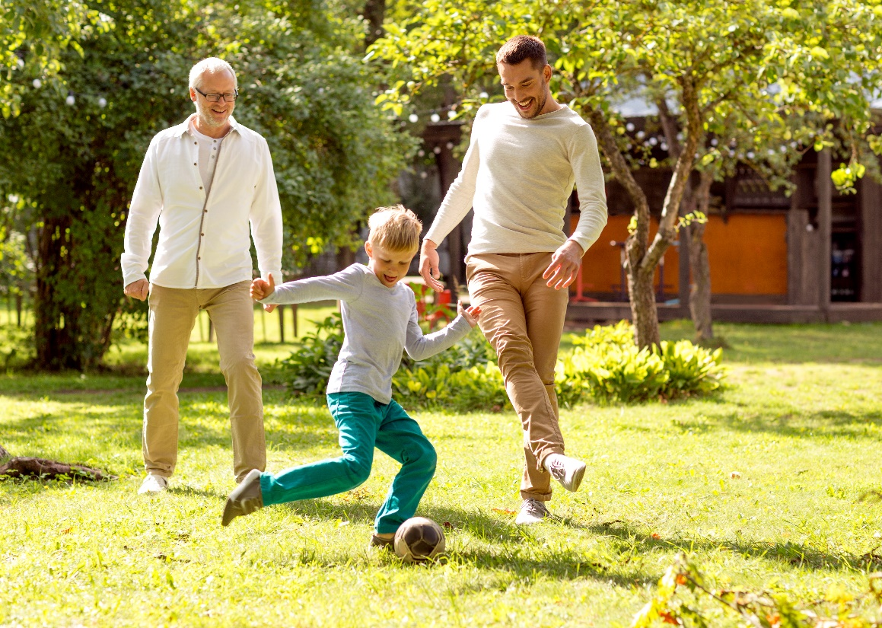
What needs to be done to get Canadian kids moving?
Families can support children and youth in achieving healthy physical activity, sedentary and sleep behaviours by encouraging, facilitating, modelling, setting expectations and engaging in healthy movement behaviours with them. Other sources of influence are important (e.g., child care, school, health care, community, governments) and can support families in this pursuit.

Slide 6
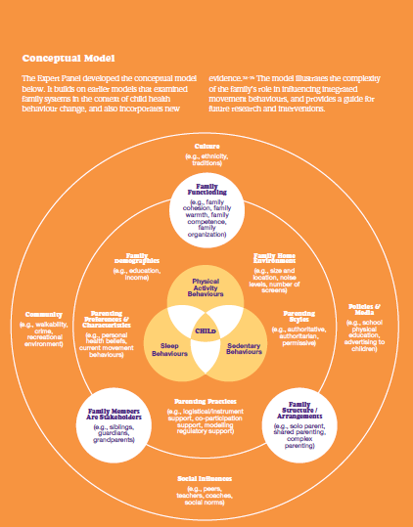
It’s Complex!
Notes:
The Expert Panel developed the conceptual model below. It builds on earlier models that examined family systems in the context of child health behaviour change, and also incorporates new evidence.^{74–76} The model illustrates the complexity of the family’s role in influencing integrated movement behaviours, and provides a guide for future research and interventions.

Slide 7
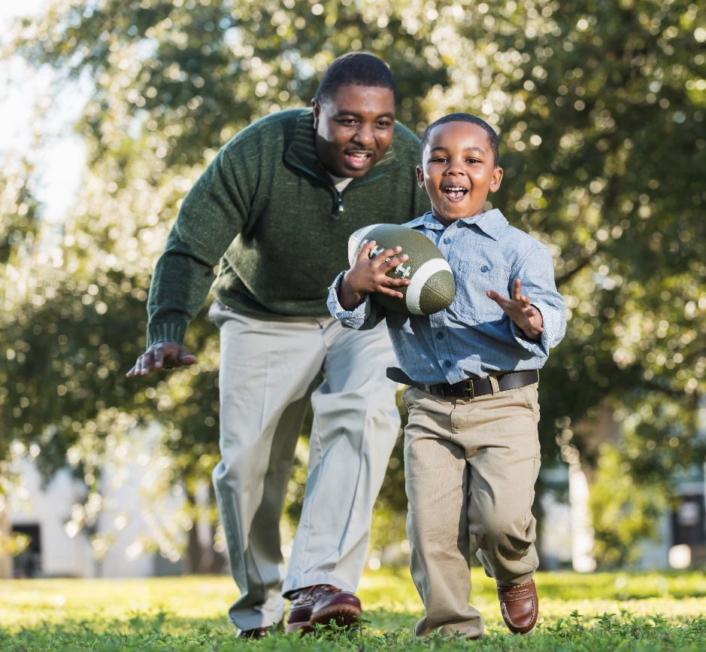
Recommendations
Parents, be an active role model in kids’ lives
Each additional 20 min of physical activity by parent = 5+ min in child’s physical activity.^{Custom analysis}
Facilitate physical activity by encouraging, watching, role modelling, co-participating and attending physical activity events.^{50,52,78–91}
Be active as a family and make it a priority.⁹²
As a Family, reduce screen time or put screens away – get active instead
52% of parents said they spend too much time on their phones, up from 29% in 2016.
By age 11, over half (53%) of children have their own smartphone, and this increases to 69% by age 12.⁶²
1/3 of youth keep their phones in bed with them⁶⁰
Notes:
Parents, be an active role model in kids’ lives
Each additional 20 minutes of moderate to vigorous physical activity by a parent is associated with an additional 5 minutes in their child’s daily physical activity.^{Custom analysis}
Facilitate physical activity by encouraging, watching, role modelling, co-participating and attending physical activity events.^{50,52,78–91}
Be active as a family and make it a priority – this encourages physical activity, social support, connectedness and attachment, which are all important for good mental health.⁹²
As a Family, reduce screen time or put screens away – get active instead
52% of parents said they spend too much time on their mobile devices, up from 29% in 2016.
Also, the proportion of children and youth who thought their parent(s) was/were addicted to their mobile devices and wished their parent(s) would get off their device increased from 28% in 2016 to 39% in 2019.⁶⁰
By age 11, over half (53%) of children have their own smartphone, and this increases to 69% by age 12.⁶²
One-third of youth keep their mobile devices in bed with them⁶⁰ – and those with screens in their bedroom get less sleep

Slide 8
Recommendations
Reclaim family time as active time
When we identify our families as active ones, then our children are much more likely to identify as active individuals.³²⁴
Use active transportation to get to destinations as a family
Whether you walk, wheel, rollerblade, skateboard or jog, there’s a form of active transportation for everyone. Try leaving the car at home once or twice a week – not only will you save money on gas and reduce harmful emissions, but you will also be spending more quality time as a family getting active.
Encourage more outdoor time
  Spending some time outdoors each week as a family is an easy and effective way to limit screen time and naturally boost moods, and it can also decrease sedentary behaviour and improve sleep quality.⁷⁷

Slide 9
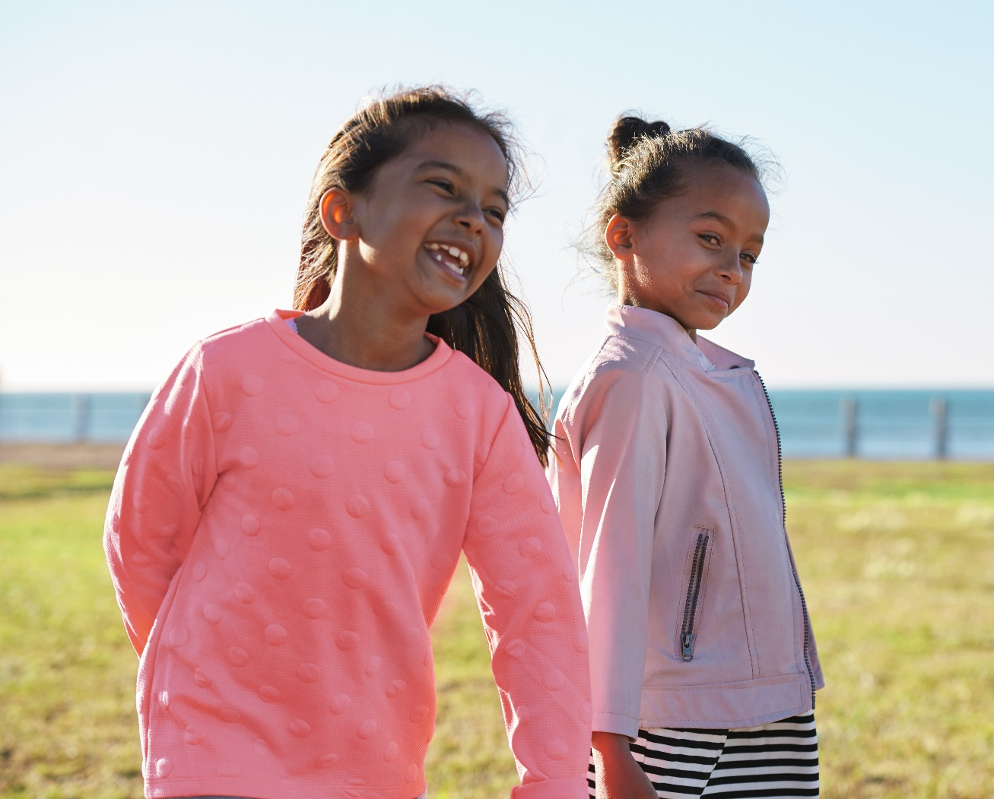
Indicators & Grades
Grades are determined by the best available data, research and key issues from the past year.

Slide 10
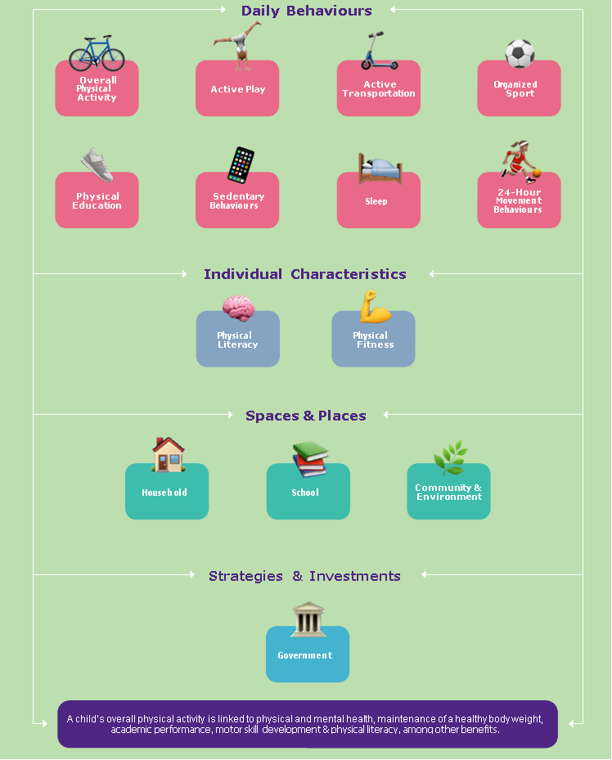
Conceptual Model
Notes:
Add conceptual model from designed FULL RC

Slide 11
Indicators
Children’s movement behaviours are affected by the family, home, school, community, government and environment.
Daily Behaviours: Overall Physical Activity, Active Play, Active Transport, Organized Sport, Physical Education, Sedentary Behaviours, Sleep, and 24-Hour Movement Guidelines
Individual Characteristics: Physical Literacy and Physical Fitness
Spaces and Places: Household, School , Community and Environment
Strategy and Investments: Government

Slide 12
Methodology
Our interdisciplinary research team identifies and assesses Report Card indicators to determine grade assignments based on the best available data, research and key issue areas from the past two years, all of which are included in the Full Report.
  A = We are succeeding with a large majority of children and youth.
  B = We are succeeding with well over half of children and youth.
  C = We are succeeding with about half of children and youth.
  D = We are succeeding with less than half, but some, children and youth.
  F = We are succeeding with very few children and youth.
Although no longer factoring into grade assignments, trends over time and disparities related to factors such as age, gender or household income are highlighted where applicable

Slide 13

The Grades
Daily Behaviours

Slide 14
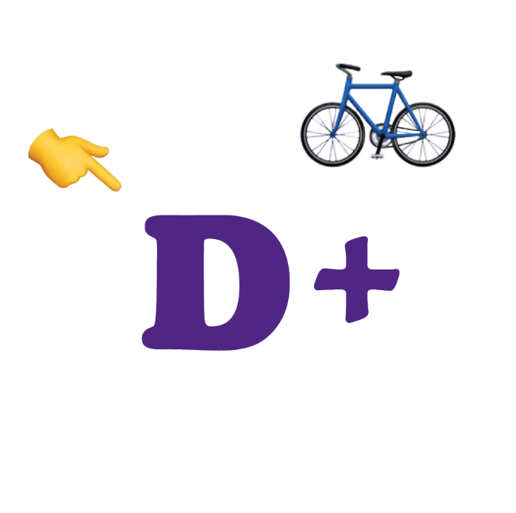
Overall Physical Activity
39% of 5- to 17-year-olds in Canada meet the physical activity recommendation within the Canadian 24-Hour Movement Guidelines for Children and Youth (2016-17 CHMS, Statistics Canada).^{Custom analysis}
41% of 5- to 19-year-olds take at least 12,000 steps daily on average, which approximates the physical activity recommendation within the Canadian 24-Hour Movement Guidelines for Children and Youth (2018 CANPLAY, CFLRI).⁴⁶

Slide 15
Overall Physical Activity
Research Gaps
Recommendations
How much light-intensity physical activity is needed within a 24-hour period for optimum health?
Does the association between physical activity and health outcomes vary by type or domain of physical activity?
What percentage of children and youth are 5, 10 or 20 minutes short of meeting the target.
How to effectively promote physical activity among vulnerable groups?
Physical activity promotion efforts should focus on reducing inequalities and inequities.
Improve surveillance protocols and implement consistent criteria “for meeting the guidelines”. to allow for improved comparisons across years.
Promote physical activity early and often.
Consider important age- and sex-related differences in overall levels of physical activity.
Notes:
Development, validation and refinement is needed of questionnaires that capture physical activity from different domains (including home, school, sport and leisure time).
Funding from various levels of government should continue to be committed to the surveillance of physical activity in children and youth by province/territory.

Slide 16
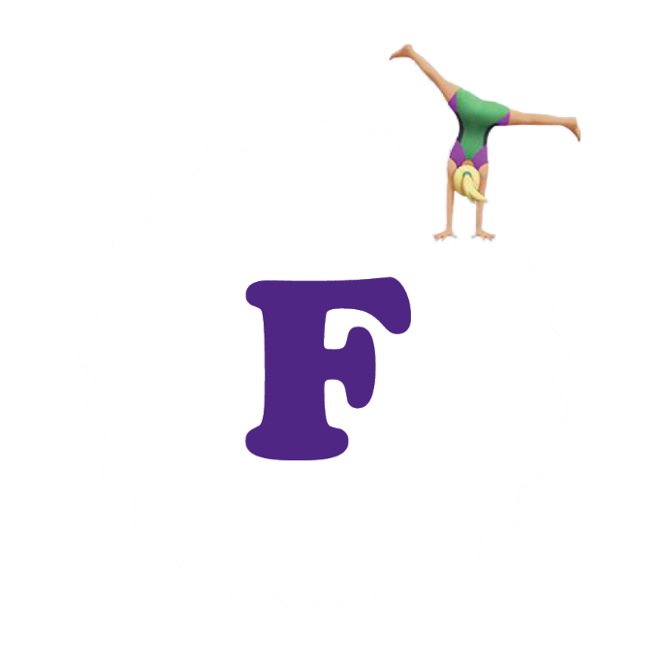
Active Play
21% of 5- to 11-year-olds in Canada spend several hours (> 1.5 hours) a day in unorganized physical activity, according to their parents (2016-17 CHMS, Statistics Canada).^{Custom analysis}
Children and youth in grades 6 to 10 in Canada report playing outdoors for 15 minutes per day, on average (2018 HBSC).^{Custom analysis}

Slide 17
Active Play
Research Gaps
Recommendations
Further research is required to establish a benchmark that is linked to health outcomes.
A standardized, cost-effective, population-based measurement approach of active play is needed.
How does play (or perception of play) vary with age?
More research is needed on the contribution to play within various venues settings.
How do levels of active play vary by features of the built environment?
Promote and support outdoor play opportunities.
Nurture frequent active play opportunities.

Slide 18
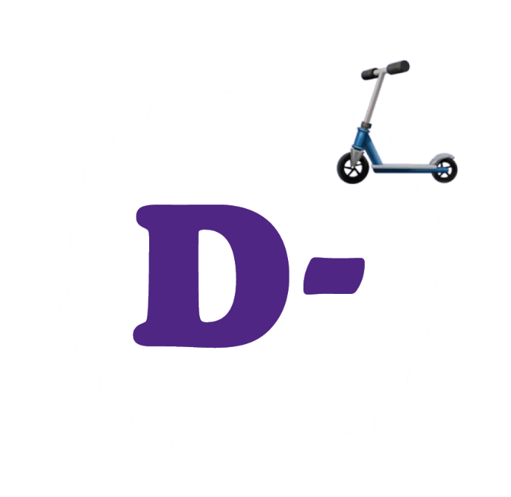
Active Transportation
Based on parent- and self-report data in 5- to 19-year-olds in Canada, 21% typically use active modes of transportation (e.g., walk, bike), 63% use inactive modes (e.g., car, bus) and 16% use a combination of active and inactive modes of transportation to travel to and from school (2014-16 CANPLAY, CFLRI). ^{Custom analysis}

Slide 19
Active Transportation
Research Gaps
How frequently do children and youth engage in active travel to and from destinations other than school?
Researchers should consider using objective measures of active transportation (e.g., GPS loggers) in their studies.
Active school travel intervention research is needed in Canada that includes appropriate time for follow-up.
Research is needed that focuses on older children and the feasibility of interventions to promote active school travel among teenagers.
How best can independent mobility be facilitated in children and youth?
How do mixed modes of transportation contribute to the accumulation of daily physical activity?

Slide 20

Active Transportation
Recommendations
Consider letting children walk or bicycle to destinations that are within a few kilometres of home.
Create a culture of active transportation, similar to many European and African nations.
Increase traffic control and supervision to facilitate active transportation in children and youth.
Schools should develop an active school travel plan that encourages children to use active modes of transportation.
Consider the use of “walking school buses”.
Notes:
Educational initiatives may also be helpful in promoting the broad benefits of active travel and in reframing parental perceptions of risk.

Slide 21

Organized Sport
According to parents, 77% of 5- to 19-year-olds participate in organized physical activities or sports (2014-16 CANPLAY, CFLRI).¹⁰⁹
66% of students in grades 6 to 10 currently participate in individual and/or team sports, based on self-report data (2018 HBSC).^{Custom analysis}

Slide 22
Organized Sport
Research Gaps
Recommendations
Understanding the contribution of school-based vs. community-based sport participation is important.
More data on physical activity and sport participation among Indigenous children and youth is needed.
Examine the effectiveness of programs that subsidize sport participation for low-income families.
Further understanding is required of children’s and youths’ engagement in sport in rural and remote regions of the country.
Expose children to a variety of different sports as opposed to early sport specialization.
Ensure sport offerings are inclusive of children with disabilities.
Provide sport offerings that are attractive to children of new immigrant families and those from a variety of ethnic, socio-economic and cultural backgrounds.
Notes:
Support sport policymakers and practitioners with tools and information on applying shared principles, strategies and interventions across community sport and recreation, education and public health
Tracking should be conducted on a regular basis of progress on the sport and recreation recommendations in the Truth and Reconciliation Commission report for Indigenous youth.

Slide 23

Physical Education
37% of 5- to 11-year-olds in Canada receive at least 150 minutes of physical activity per week during class time at school, according to their parents (2016-17 CHMS, Statistics Canada).^{Custom analysis}
36% of 12- to 17-year-olds in Canada report getting at least 150 minutes of physical activity per week during class time and free time at school (2016-17 CHMS, Statistics Canada).^{Custom analysis}

Slide 24
Physical Education
Research Gaps
Recommendations
Examine the disconnect between PE/DPA policies and low adherence rates.
Examine objectively measured physical activity levels in PE class.
Accurate understanding of the uptake and implementation of DPA in schools is warranted.
Update numbers on the proportion of students receiving instruction from PE specialists.
Schools should treat PE and DPA with the same respect as they do core subjects.
Focus on enjoyment and inclusiveness rather than on competition and specialization.
Prioritize efforts to increase PE frequency and enhance the PE curriculum to support children’s and youths’ movement behaviours and learning.
Invest in training generalist teachers in PE-specific skills.

Slide 25
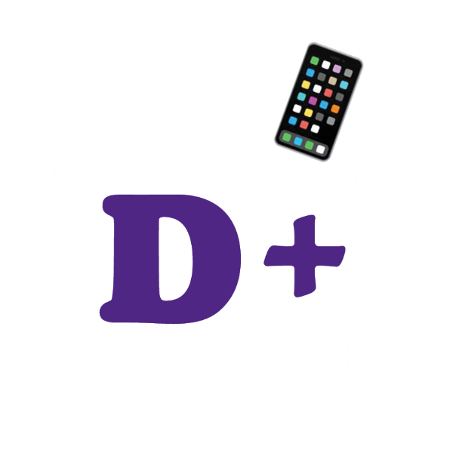
Sedentary Behaviours
76% of 5- to 11-year-olds (2016-17 CHMS, Statistics Canada).
  More girls than boys in this age group meeting the recommendation (80% vs. 71%).
28% of 12- to 17-year-olds (2016-17 CHMS, Statistics Canada).
  More girls than boys in this age group meeting the recommendation (30% vs. 25%).

Slide 26
Sedentary Behaviours
Research Gaps
Recommendations
More data is needed on the amount of time children and youth spend on smartphones.
More objective measurement of screen-based sedentary behaviours is needed.
What is the impact of replacing screen-based sedentary behaviours with non-screen-based sedentary behaviours?
Develop and validate a standardized questionnaire that captures multiple aspects of sedentary behaviour including screen time, passive travel, sitting at school, etc.
Involve all family members in the creation of a family media plan.
All family members should be mindful of their own time spent on screens.
Be present and engaged when screen viewing and avoid using multiple screens at once (“stacking”).
Notes:
Involve all family members in the creation of a family media plan that includes setting limits around screen viewing, prioritizing screen-free family time, removing screens from children’s bedrooms and having screen-free family meals
Current data on daily screen use is based on self- or parent-report surveys, which have a high risk of bias. New technologies allow for the objective measurement of screen-based sedentary behaviours, which could lead to more accurate measurement of these behaviours among children and youth.

Slide 27
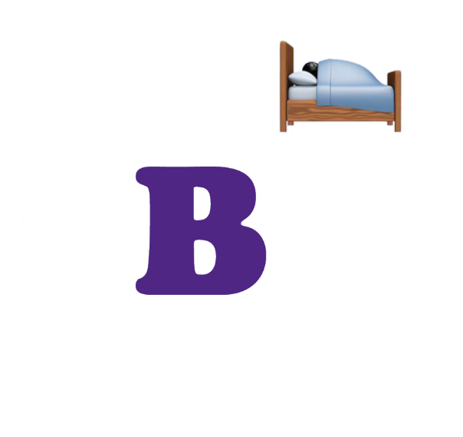
Sleep
Approximately 70% of school-aged children and youth in Canada meet the sleep recommendation within the Canadian 24-Hour Movement Guidelines for Children and Youth:
  74% of 5- to 17-year-olds (2014-15 CHMS, Statistics Canada).^{Custom analysis}
  65% of students in grades 6 to 10 (2018 HBSC).^{Custom analysis}

Slide 28

Sleep
Research Gaps
Test the cost-effectiveness of public health policy recommendations aimed at improving sleep and health outcomes in children and youth.
Objective monitoring of sleep is needed to have a better picture of sleep health of young Canadians.
A consensus needs to be reached on the characteristics used to assess sleep health of the pediatric population.
Sleep questions used in national health surveys need to be updated and validated to reflect new research.

Slide 29
Sleep
Recommendations
Canada needs a national media campaign that aims to change the social norm around sleep as being a waste of time.
Middle and high schools should not start classes earlier than 8:30 a.m.
Daylight savings time should be eliminated.
Extracurricular activities for adolescents should end no later than 9:00 p.m.
Sleep health literacy should be integrated into school curriculums.
Notes:
Regulations related to healthy sleep practices in childcare facilities are lacking or vary widely. Healthy sleep practices in childcare settings should adopt regulations consistent with evidence-based recommendations.
Middle and high schools should not start classes earlier than 8:30 a.m., to accommodate the well-known circadian phase delay of up to two hours that occurs in middle childhood.
Daylight savings time should be eliminated because it is disruptive to sleep and linked to accidents and adverse effects on health.

Slide 30

24-Hour Movement Behaviours
Less than a fifth of children and youth in Canada meet all three recommendations within the Canadian 24-Hour Movement Guidelines for Children and Youth:
  15% of 5- to 17-year-olds (2014-15 CHMS, Statistics Canada).^{Custom analysis}
  10% of students in grades 6 to 10 (2018 HBSC).^{Custom analysis}

Slide 31
24-Hour Movement Behaviours
Research Gaps
Recommendations
More objective measurement of all movement behaviours is needed.
Research is needed that examines intermediate combinations of movement behaviours (e.g., high physical activity + low sedentary behaviour + high sleep vs. low physical activity + high sedentary behaviour + low sleep).
Speak to parents, teachers and clinicians about how these behaviours contribute to the children’s overall health and well-being.
Encourage parents to implement specific plans that support children’s movement behaviours.

Slide 32
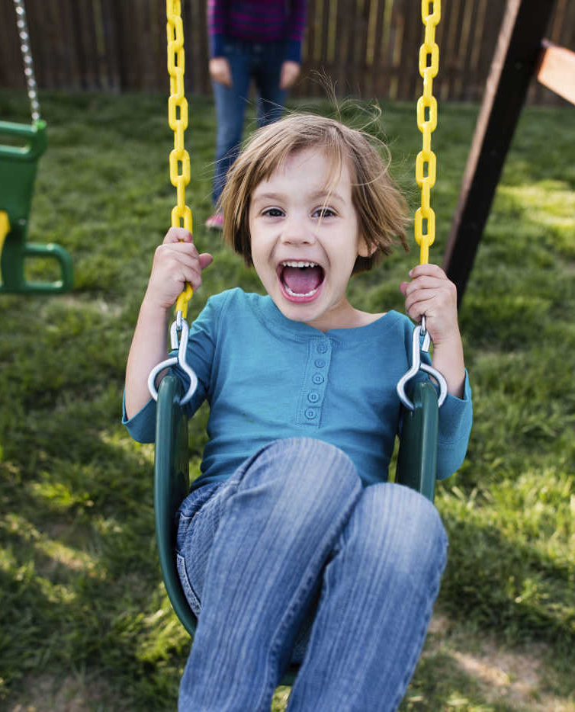
The Grades
Individual Characteristics

Slide 33
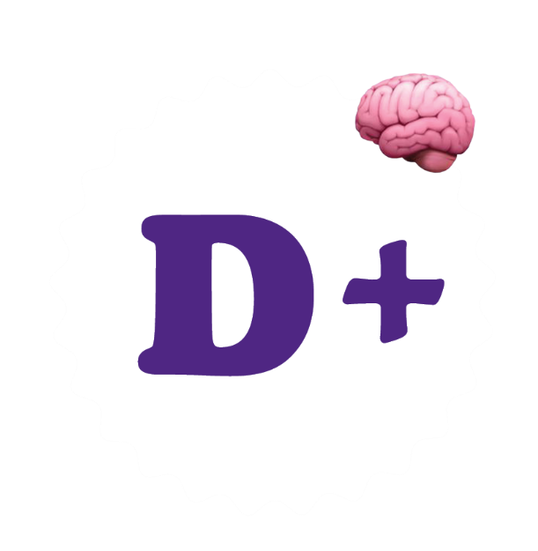
Physical Literacy
36% of 8- to 12-year-olds in Canada assessed by the CAPL meet or exceed the minimum level recommended for physical literacy (2014-17 CAPL, HALO).¹⁷⁶

Slide 34
Physical Literacy
Research Gaps
More evidence is required to support the role of physical literacy as a determinant of overall health.
More physical literacy research among specific populations is needed.
More research on physical literacy and sport injury prevention/management would benefit young athletes.
Further assessment using validated measures of physical literacy is needed.
Self-report questionnaires that assess physical literacy are needed.
Development of tools that assess physical literacy in young children are required.
Notes:
The sensitivity and specificity of tools that measure physical literacy should be evaluated with children who demonstrate low levels of physical literacy, as well as those who live with physical disabilities.

Slide 35
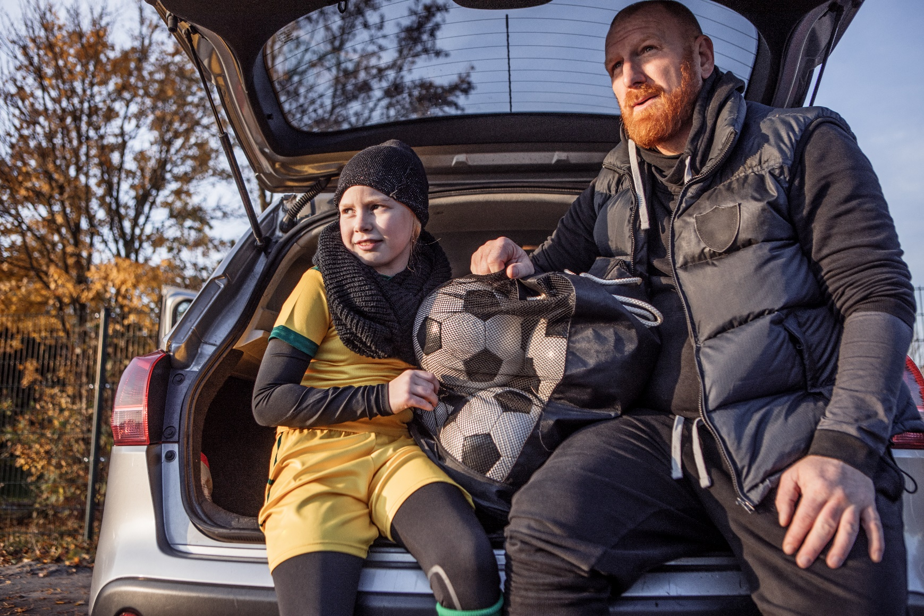
Physical Literacy
Recommendations
Interventions addressing physical literacy development should focus on combined physical and psychosocial factors as well as individual characteristics.
Use a combination of physical literacy assessment tools to provide a more holistic and accurate representation of physical literacy.
Notes:
Interventions addressing physical literacy development should focus on combined physical and psychosocial factors as well as individual characteristics. For example:
Programs should not only focus on developing fundamental movement skills, but also on targeting physical competence as a whole (e.g., strength, agility, endurance).
Leaders should use evidence-based, motivational strategies that are theoretically supported to promote confidence in children during active play. Fostering motivation and confidence is especially important for children who have limitations in physical competence.
During competitive games, the social environment should prioritize teamwork and fun over scoring and winning

Slide 36

Physical Fitness
9- to 12-year-olds in Canada are at the 28th percentile, on average, for cardiorespiratory fitness (shuttle run in 20-metre laps) based on age- and sex-specific international normative data (2014-17 CAPL, HALO).²⁰³

Slide 37
Physical Fitness
Research Gaps
Recommendations
How does musculoskeletal strength and endurance impact important health behaviours (e.g., sleep).
How does levels of sedentary behaviour and physical activity throughout the school day influence musculoskeletal and cardiorespiratory fitness?
Examine the validity of the modified Canadian Aerobic Fitness Test (mCAFT) step test.
Understand fitness and physical activity temporal changes among children and youth.
Parents, teachers and healthcare practitioners should encourage children to participate in a range of activities that support the development of cardiorespiratory and musculoskeletal fitness.
Continue to assess the physical fitness of Canadian children and youth.
Investigate and share information on best practices for improving physical fitness in children and youth.
Notes:
Future researchers should aim to develop criterion-referenced standards.

Slide 38
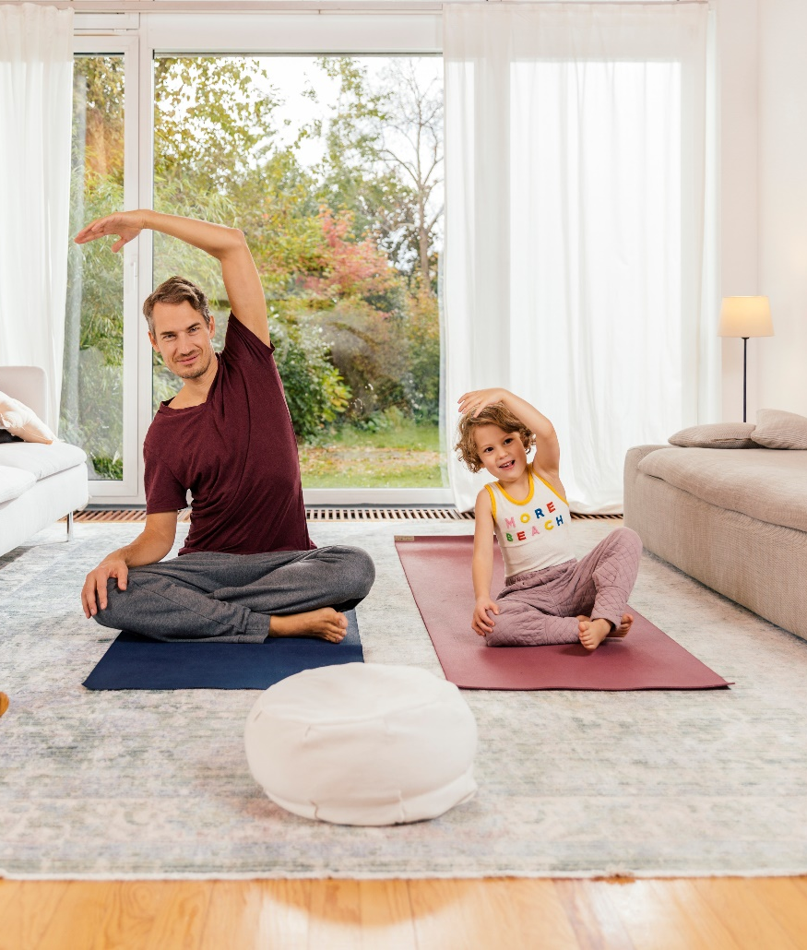
The Grades
Spaces & Places

Slide 39
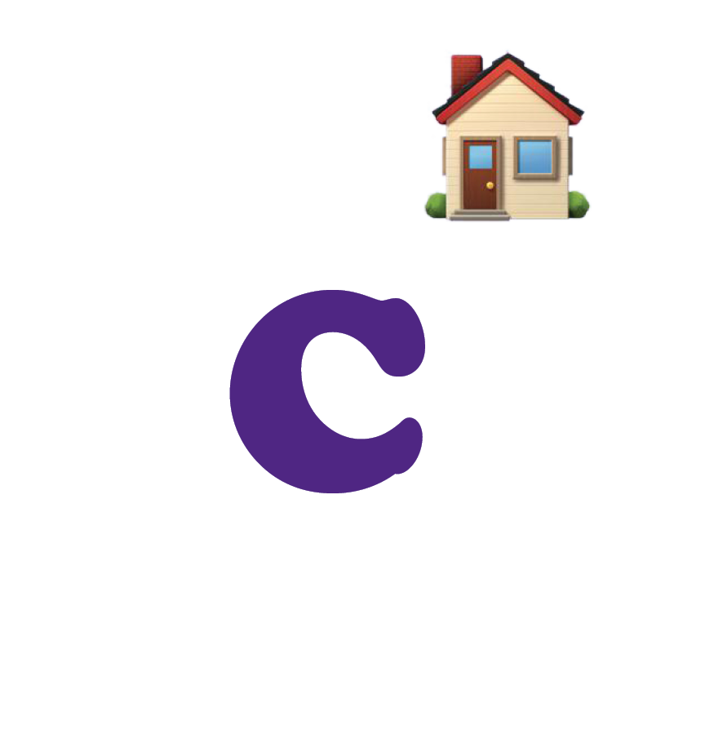
Household
16% of 18- to 39-year-olds and 17% of 40- to 59-year-olds in Canada meet the Canadian Physical Activity Guidelines for Adults (2016-17 CHMS).
44% and 23% of Canadian parents report providing support for children’s and youths’ light physical activity and MVPA, respectively.²²²
92% of students in grades 9 to 12 in British Columbia, Alberta, Nunavut, Ontario and Quebec report having parents/step-parents/guardians who support them in being physically active (2016-17 COMPASS, University of Waterloo).

Slide 40
Household
Research Gaps
Recommendations
Determine whether physical activity programs geared toward the entire family result in better benefits than programs focused on individuals.
Identify how peer and family influences develop and change throughout the course of childhood and adolescence.
Examine the link between peer influence, and structured and unstructured physical activities.
Programs that encourage families to be active together should be better supported.
National data are required on how the physical activity of children and youth is influenced by their peers.

Slide 41

School
48% of school administrators in Canada report having a fully implemented policy to provide daily physical education or mandated daily physical activity to all students.²⁵⁸

Slide 42
School
Research Gaps
Recommendations
There is a need to understand how different school schedules influence students’ movement behaviours during the school day and outside school hours.
Research is needed to explore the characteristics of school-based physical activity policies to identify which policies support children’s movement.
Schools should give students a voice and involve them in the development of their physical activity curriculum, policies and outdoor play spaces.
Indoor recesses caused by inclement weather should not be spent on screens.
Schools should move away from a “risk assessment” approach toward a “risk-benefit assessment” approach.
Notes:
A good starting point would be to use The Risk Benefit Assessment for Outdoor Play: A Canadian Toolkit, which is available at www.outdoorplaycanada.ca/wp-content/uploads/2020/02/risk-benefit-assessment-for-outdoor-play-a-canadian-toolkit.pdf

Slide 43

Community & Environment
Among municipalities in Canada with at least 1,000 residents, as many as one-third have policies that relate to physical activity (2015 SPAOCC, CFLRI):
  35% have formal strategies for physical activity and sport opportunities.²⁸¹
  22% have a formal plan regarding active transportation.²⁸²
  25% and 33% have a policy requiring safe pedestrian and bicycle routes, respectively.
  24% have a formal transportation master plan.

Slide 44
Community & Environment
Research Gaps
Recommendations
Little is known about how community planning in Canada integrates strategies to promote physical activity.
Examine how to promote greater uptake of those community-based programs and facilities.
Health economic analyses and policy evaluations are needed to translate research on the built environment into the development of effective policy and planning initiatives that promote healthy active living.
Communities should dedicate part of their capital plan to recreation facility revitalization.
All parents and children should have access to inclusive out-of-school-time physical activity programs.
Municipal policies or bylaws that restrict physical activity or outdoor play for children and youth should be revisited.
Notes:
Health economic analyses and policy evaluations that incorporate case studies and natural experiments are needed in order to translate research on the built environment into the development of effective policy and planning initiatives that promote healthy active living.

Slide 45
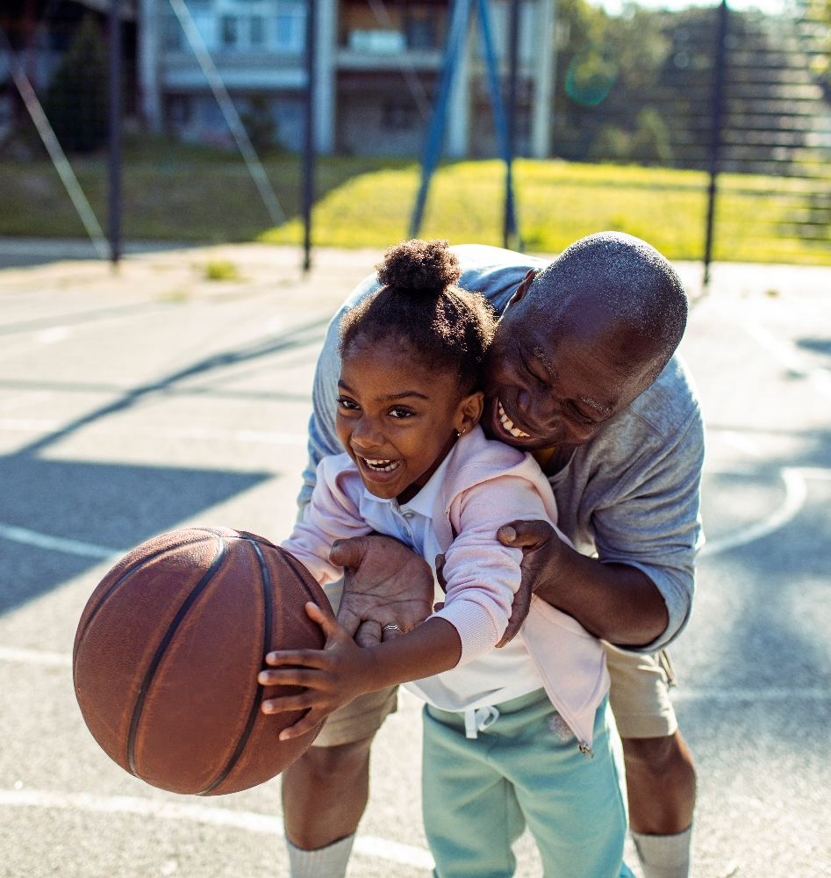
The Grades
Strategy & Investment

Slide 46

Government
$5 million per year for 5 consecutive years (totalling $25 million) to ParticipACTION.²⁸⁵
$30 million over 3 years to promote women’s and girls’ participation in sport. ²⁸⁵
$47.5 million over 5 years as well as $9.5 million per year ongoing to expand the use of sport for social development in more than 300 Indigenous communities.³⁰¹
Almost 70% of federal, provincial and territorial governments report that funds invested in physical activity programming has remained the same over the past fiscal years (2019 ParticipACTION).
Over 90% of federal, provincial and territorial governments reported modifying/adapting their physical activity policies and programs to better align with the Common Vision (2019 ParticipACTION).

Slide 47
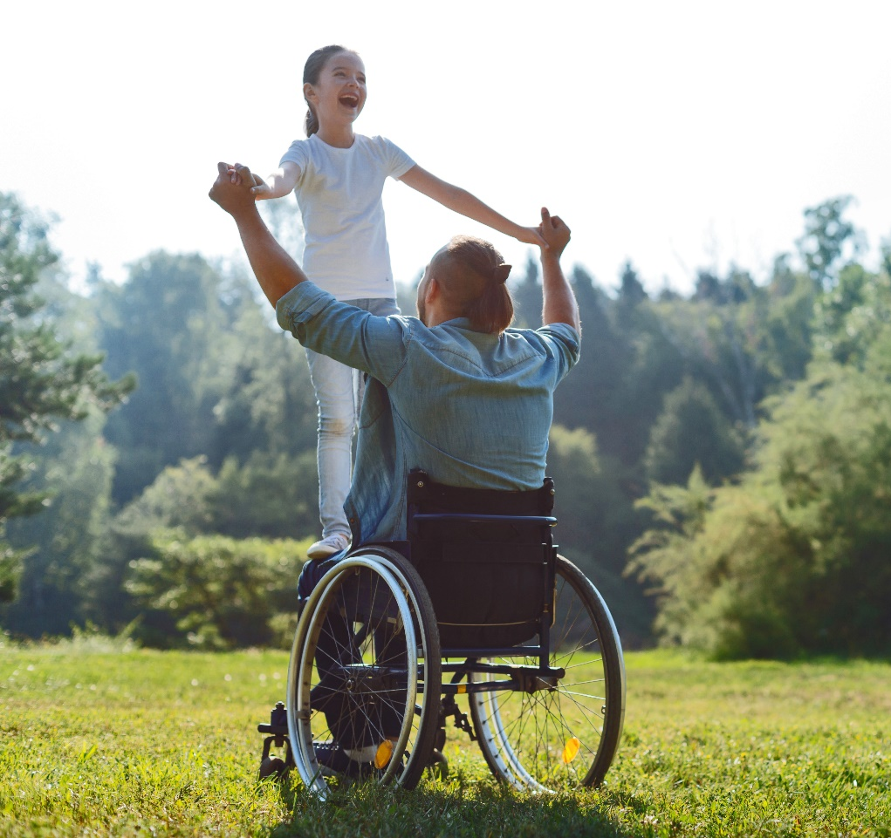
Government
Research Gaps
Gain a better understanding of what is required in financial, human and program resources to reverse negative trends in physical activity and sedentary behaviour in Canadian children and youth.
There is an ongoing need to implement common tools and metrics for measuring all movement behaviours at the national-, provincial-, and territorial-level.
Natural experiments should be evaluated, with the outcomes and results documented and impact shared.
More insight is required on the extent to which governments are subsidizing the cost of children and youth participation in organized sport and recreation programs.

Slide 48
Government
Recommendations
Enhance collaboration and alignment across federal, provincial, territorial and local governments.
Give voice to children and youth by engaging them directly in efforts to conceive, design, develop, implement and evaluate physical activity policies, programs and services.
Provide leadership development, training and community capacity building for those living in rural or remote communities.
Work with other domestic and international organizations to add to current understanding of the investment required to increase population physical activity in Canada.
Governments at all levels should intentionally address people who are at the greatest risk for inactivity, by supporting policies that eliminate disparities that impact physical activity levels.
Notes:
Enhance capacity and consistency in childcare settings and schools to provide opportunities to develop physical literacy, such as through curriculum-based physical activity delivered by qualified instructors.
Invest in training around understanding the importance of the natural and outdoor environment as it relates to play education.
Three distinct but integrated national policy frameworks exist to advance physical activity opportunities for Canadians across sport (Canadian Sport Policy), recreation (A Framework for Recreation in Canada: Pathways to Well-Being) and physical activity (A Common Vision for Increasing Physical Activity and Reducing Sedentary Living in Canada: Let’s Get Moving!). The Common Vision identifies opportunities for alignment and convergence of policy and program opportunities to increase population physical activity across all three frameworks, including among children and youth.

Slide 49
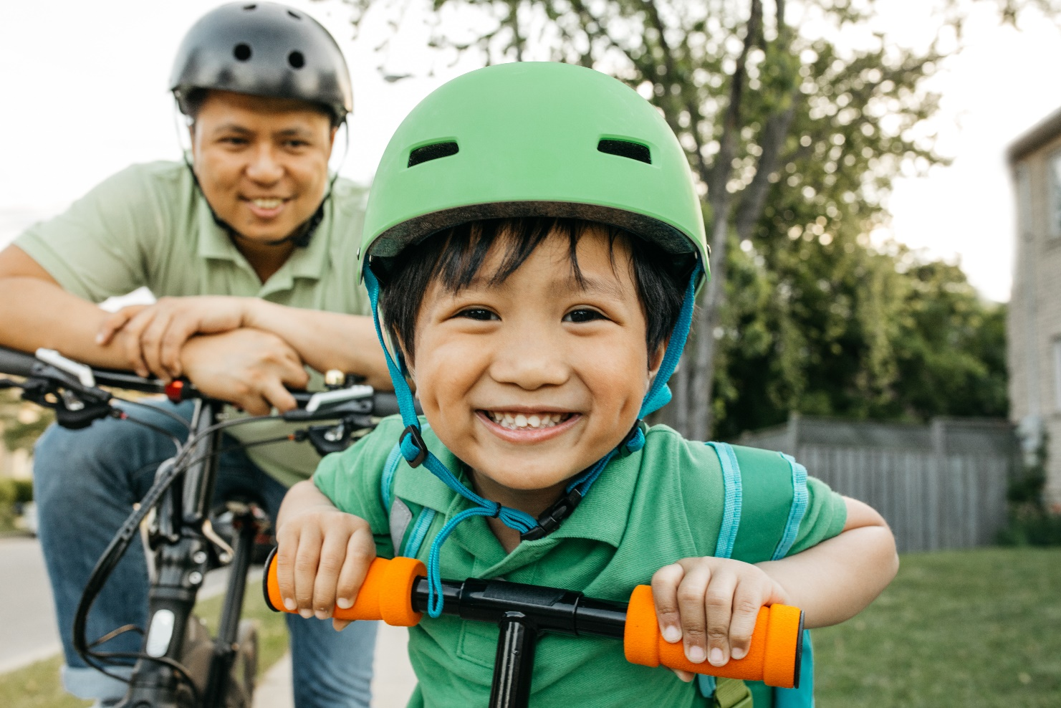
In Closing

Slide 50

Tools & Resources
(EN & FR)
2020 ParticipACTION Report- Highlight Report
2020 ParticipACTION Report- Full Report
Consensus statement on the Role of the Family in the Physical Activity, Sedentary and Sleep Behaviours of Children and Youth
Past Report Cards
Power Point presentation
Media materials
Communications Toolkit
Infographics

Slide 51
Report Card
Development Team
Report Card Chief Scientific Officer
Dr. Mark Tremblay
Research Manager and Lead Author
Dr. Michelle Guerrero
Highlight Report Writer
Flip Livingstone
Dr. Leigh Vanderloo
Project Management
Joel Barnes
Dr. Michelle Guerrero
Dr. Mark Tremblay
Dr. Leigh Vanderloo
Marketing and Communications
Rebecca Jones
Flip Livingstone
Design and Production
Hambly & Woolley Inc.
Public Relations
Proof Inc.
Copy Editing
Ruth Hanley
Dr. Geneviève Leduc
Translation Services
Marie-Johanne Tousignant
(Stratégie Rédaction)
Réseau Accès Participation
Report Card Research Committee
Dr. Christine Cameron
Dr. Valerie Carson
Dr. Jean-Philippe Chaput
Dr. Rachel Colley
Joe Doiron
Dr. Guy Faulkner
Dr. Ian Janssen
Dr. Travis Saunders
Dr. John C. Spence
Dr. Trish Tucker
Research and Content Development Team
Angelica Blais
Dr. Jean-Philippe Chaput
Dr. Louise de Lannoy
Dr. Iryna Demchenko
Joe Doiron
Caroline Dutil
Dr. Gary Goldfield
Dr. Matt Hoffmann
Dr. Taru Manyanga
Irina Podinic
Dr. Scott Rollo
Evan Turner
Dr. Leigh Vanderloo

Slide 52

Contact Us
Dr. Leigh Vanderloo
ParticipACTION Knowledge Translation Manager
lvanderloo@participACTION.com
ParticipACTION’s strategic partner, the Healthy Active Living and Obesity Research Group at the Children’s Hospital of Eastern Ontario Research Institute (HALO-CHEO), played a critical role in the research and development of the 2020 Report Card:

Slide 53
Thank you.

